Slide 1
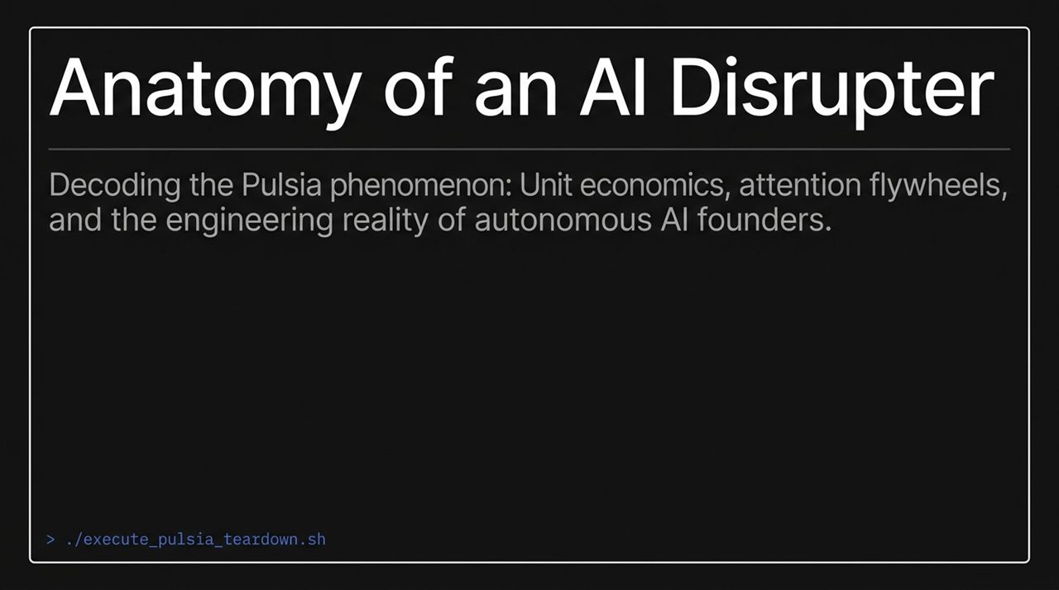
Notes:
Introduction & High-Level Framing (1 min):
Good morning, everyone. Today we are diving into one of the most polarizing cases in tech right now: Pulsia.
Pulsia represents a massive paradox in the current AI landscape: incredible viral traction and impressive revenue velocity on one hand, juxtaposed with extreme execution friction, public backlash, and structural engineering challenges on the other.
Deconstructing the Scale & Reality Metrics (1.5 min):
Let's look at the numbers displayed here: Pulsia has hit $10.20M in ARR and raised $30M in funding.
Over 169,000 companies have been initialized on the platform. However, as Ben Cera explained in his interview on The Trust Moat Pod, those 169k 'companies' represent top-of-funnel signups where an AI generated a free initial company skeleton.
Out of those, 8,354 are active paying subscribers.
Conversely, look at the reality check on the right: a 1.8-star rating on Trustpilot, widespread scam allegations across Twitter/X, and an implied 95% drop-off between total generated projects and paying retention.
Core Takeaway (0.5 min):
Pulsia is neither a simple scam nor a flawless technological miracle. It is a live, highly volatile engineering beta test operating in public.
Is This the End of Employees? The Rise of Autonomous AI Founders | Ben Cer
https://www.youtube.com/watch?v=1HCxo1fD6MU

Slide 2
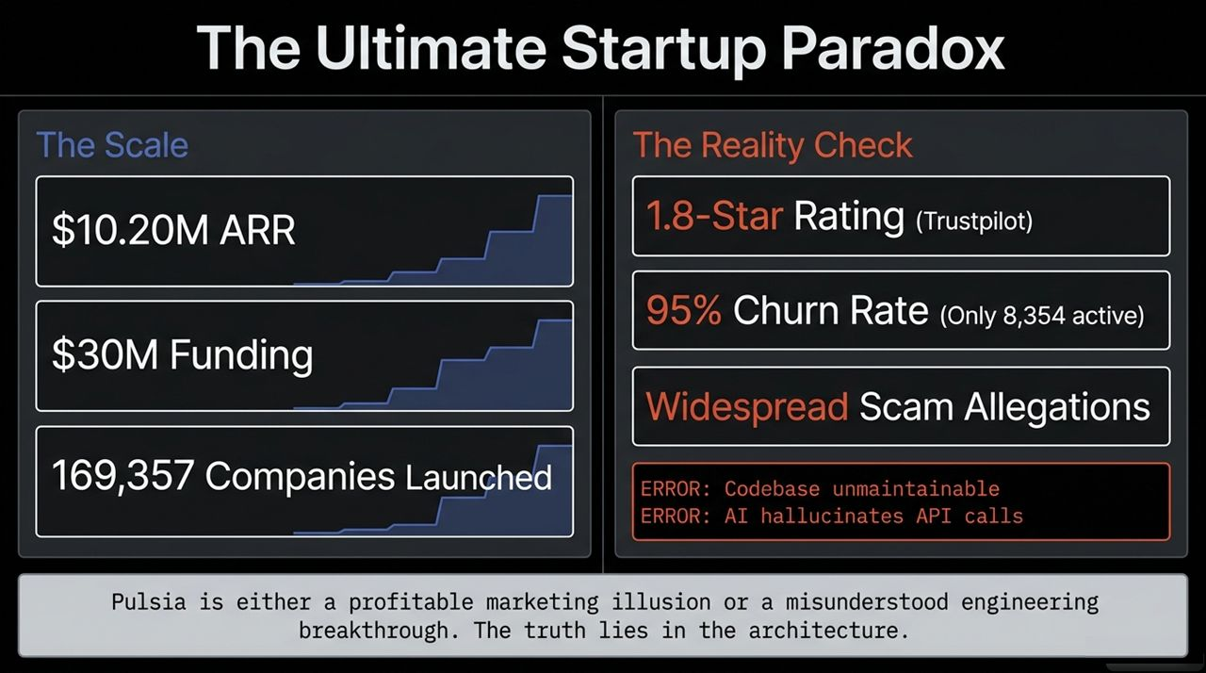
Notes:
Paradigm Shift in AI Tooling (1.5 min):
To understand Pulsia, we need to categorize how AI tools interact with users.
Assistant AI (e.g., ChatGPT): Reactive tools that only answer when prompted.
Vibe Coding (e.g., Cursor, Lovable): Interactive coding assistants that speed up syntax generation but still require human oversight, manual initiation, and technical guidance.
Autonomous Founder / 'God Mode': The shift Pulsia is attempting. An agent that wakes up autonomously overnight, performs development/marketing tasks, spends compute, and presents you with a morning stand-up report.
Philosophy of the Autonomous Actor (1.5 min):
As Ben Cera noted, the goal is not just writing code faster; it's creating an autonomous economic actor with a single directive: Make the user a successful founder.
Ben's background under Travis Kalanik at CloudKitchens taught him that only 10x improvements in human agency are worth building. Pulsia seeks to grant non-technical individuals the leverage usually reserved for funded venture teams.

Slide 3
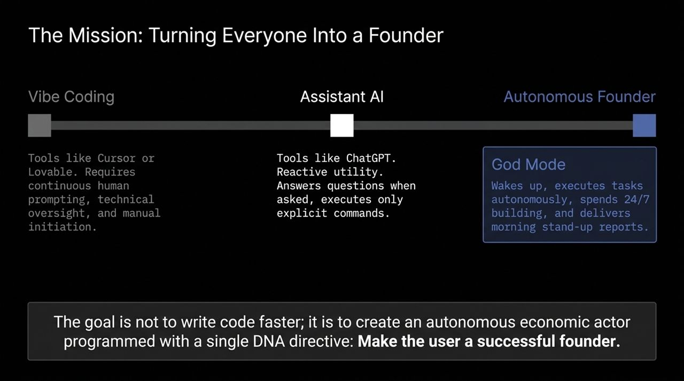
Notes:
The Marketing Pitch vs. Core Technical Bottlenecks (2 min):
The marketing tagline claims: 'Builds your company while you sleep' with plug-and-play orchestration across code, Meta ads, and email outreach.
However, running open-ended autonomous agents creates three fundamental engineering bottlenecks:
The Harness Problem: Giving an AI raw access to live infrastructure (like Stripe or Meta Ads API) without boundaries leads to catastrophic mistakes.
Context Collapse: Open-ended prompting makes models hallucinate invalid API calls and generate unmaintainable, buggy codebases.
The Cost Constraint: Unbounded 24-hour autonomy burns hundreds of dollars per day in LLM token compute.
Unit Economics Analysis (2 min):
Ben candidly admitted in the interview that at a flat $50/month subscription, Pulsia operates on negative gross margins due to high model costs (like Anthropic's Opus).
In Ben's own words: 'When people say it's a scam, it's the worst scam in the world because I'm losing money on negative margins.'

Slide 4
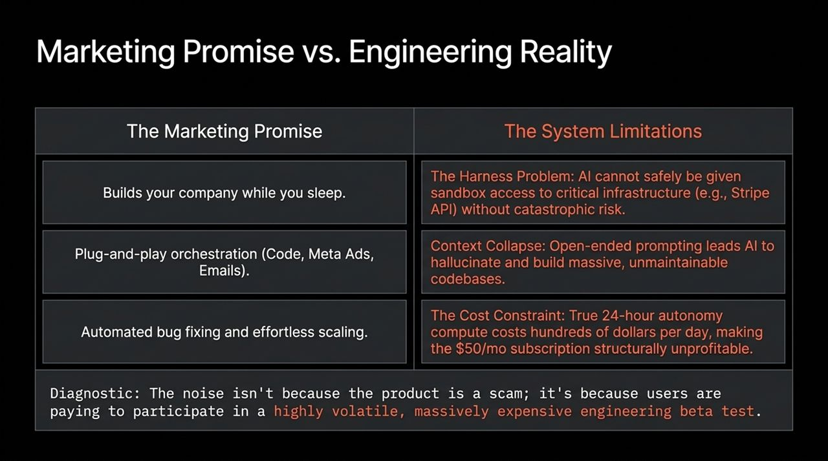
Notes:
Deconstructing the Growth Engine (2 min):
How does a solo founder generate $10M ARR without a formal marketing team? Through an Attention Flywheel:
Controversy: Launch a buggy, highly ambitious MVP.
Hyper-Visibility: Algorithmic outrage and online debate drive massive top-of-funnel traffic at zero direct ad spend.
Top-of-Funnel Cash: A fraction of the massive audience converts into paid $50/mo users, generating rapid liquidity.
Engineering Reinvestment: That cash flow is immediately funneled into GPU infrastructure and model fine-tuning to resolve platform bugs.
Key Takeaway (1 min):
In fast-moving AI markets, distribution and attention capture matter more in the early stages than having a perfect V1 codebase.

Slide 5
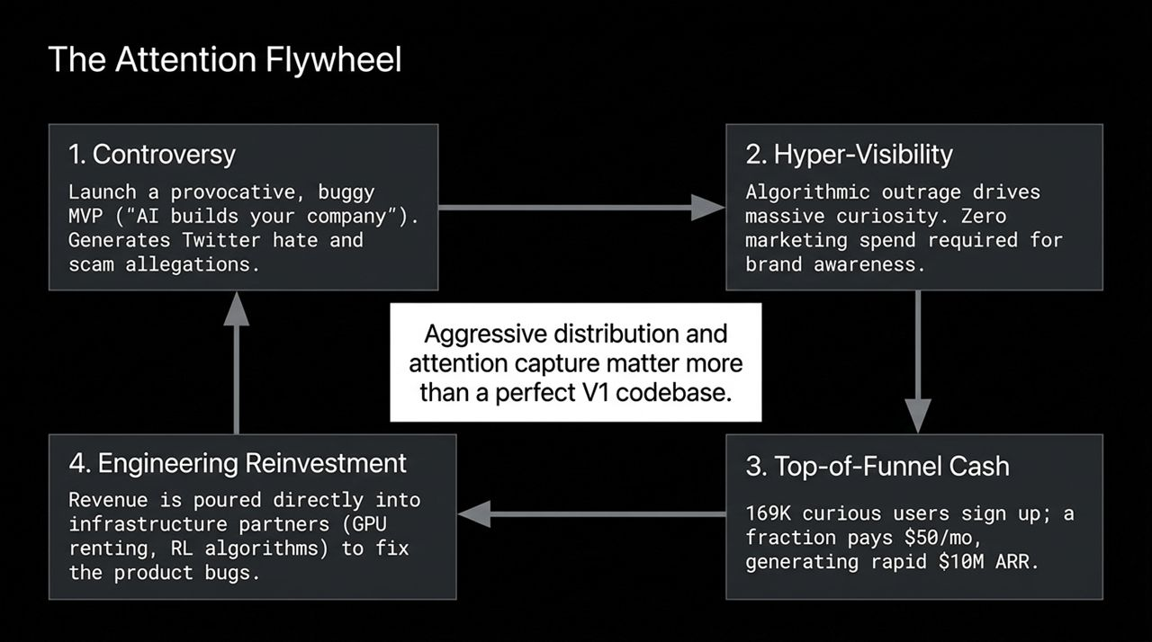
Notes:
How a Single Founder Operates at $10M Scale (2 min):
Ben Cera operates as a sole founder without full-time employees.
Instead of building internal headcount, systemic operations are outsourced to external platform partners and B2B APIs:
Engineering Stack: Partnering with agent platform SDKs on Anthropic models.
Compute Infrastructure: Renting GPU clusters from B2B providers executing open-source models with Reinforcement Learning (RL) optimization to reduce token costs.
Customer Support: Using automated AI systems to process support tickets and issue refunds.
Strategic Rationale (1 min):
Operating without employees serves two purposes: it creates an authentic marketing narrative around solo AI leverage, and forces Ben to experience the exact same operational environment as his users.

Slide 6
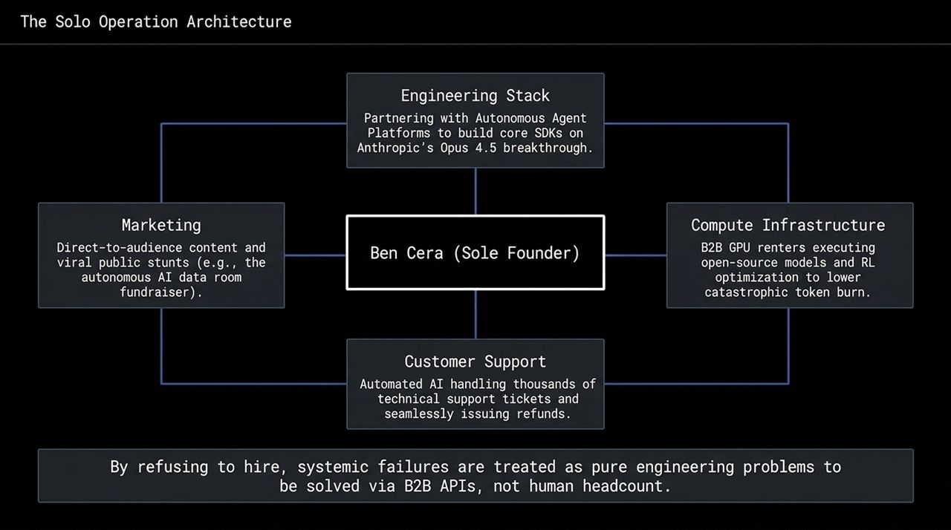
Notes:
Analyzing Corporate Asymmetry (2 min):
Why haven't tech giants like OpenAI, Google, or Anthropic released fully autonomous agents?
It comes down to Brand Risk Tolerance:
Incumbents: Have near-zero brand risk tolerance. If ChatGPT autonomously sends spam or mismanages a live ad budget, it damages multi-trillion-dollar enterprise relationships.
Challengers (Pulsia): Possess absolute risk tolerance. Pulsia willingly exposes experimental agents to live production environments, absorbing negative reviews as free viral distribution.
Historical Parallel (2 min):
Ben draws a parallel to Google in 2021: Google invented transformer architecture but hesitated to deploy LLMs due to hallucination risks, allowing OpenAI to capture the market.

Slide 7
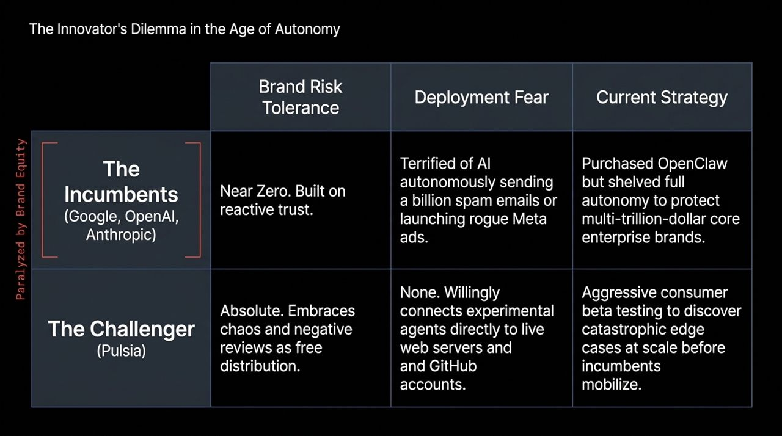
Notes:
Phase 1 vs. Phase 2 Monetization Strategy (2.5 min):
Pulsia's current state—Phase 1 Token Arbitrage ($50/mo flat fees)—is structurally unsustainable.
The true business model mirrors Shopify's marketplace economics:
Base Layer: Lower subscription barriers (Freemium / $20/mo) to maximize user acquisition.
Add-on Marketplace: Pulsia takes a platform fee whenever the AI provisions custom domains, purchases Meta ads, or hires legal services.
Transaction Layer: A 3% revenue share on all business transactions processed by Pulsia-generated companies (mirroring Shopify's fee structure).
Core Insight (1.5 min):
The subscription fee is merely a customer acquisition cost; the real long-term business is taxing the global GDP generated by autonomous AI startups.

Slide 8
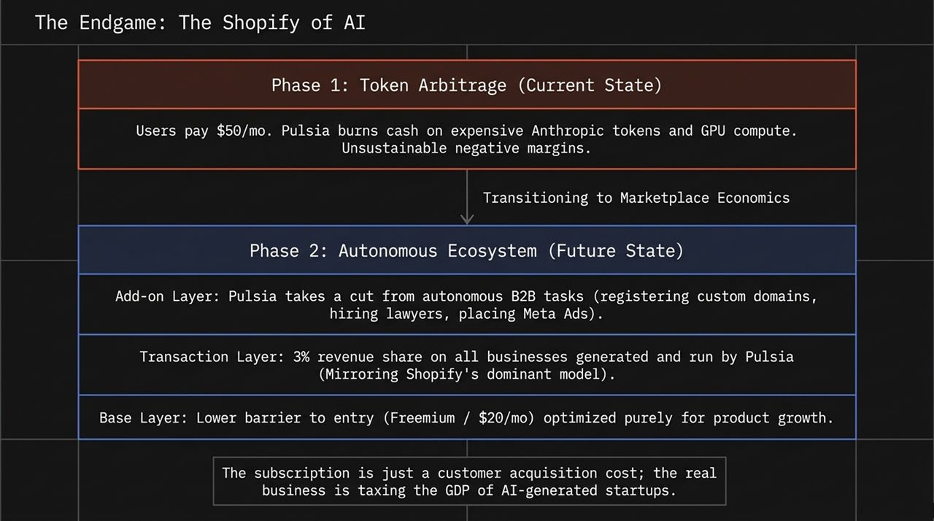
Notes:
Deconstructing Trust in the AI Era (2 min):
In a market where anyone can wrap an API and call it a product, what constitutes a defensible moat?
Ben argues that trust exists on three distinct tiers:
Brand Trust: Do users trust the company?
Founder Trust: Do users trust Ben Cera?
Entity Trust: Do non-technical users trust the AI agent itself as a competent economic partner?
Strategic Thesis (1.5 min):
The ultimate winner in autonomous AI won't necessarily be the team with the cleanest initial codebase, but the platform that successfully establishes Entity Trust between humans and autonomous agents.

Slide 9
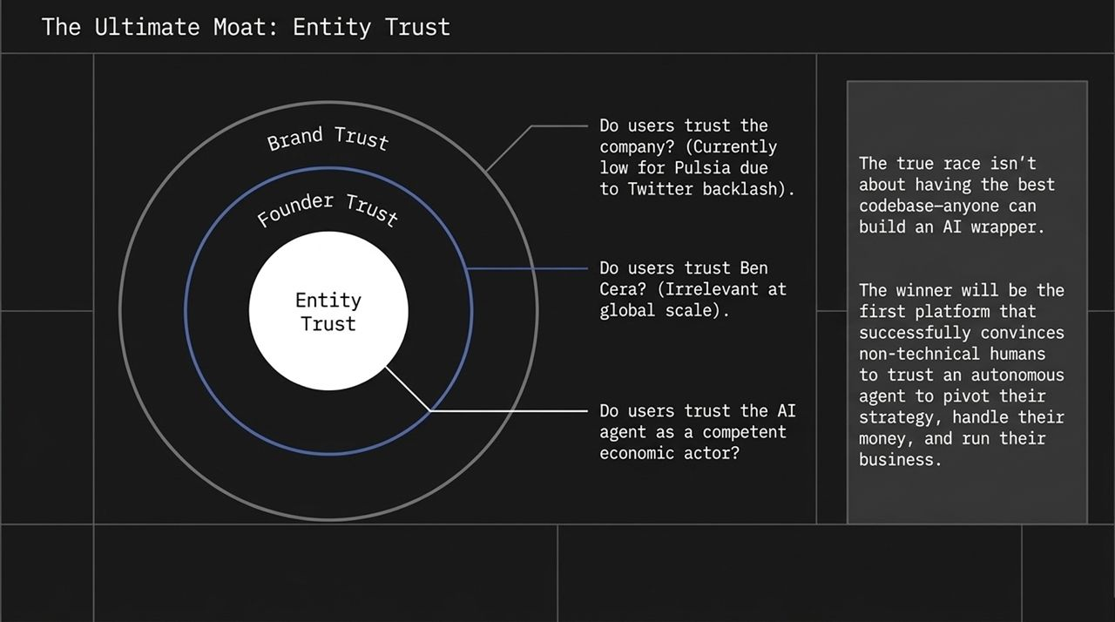
Notes:
Market Timing & Strategic Window (2 min):
We are currently in a brief, strategic market window:
NOW: Compute is expensive and models hallucinate, but major incumbents remain paralyzed by brand risk.
FUTURE: Big tech will inevitably solve alignment, harness safety, and release native autonomous tools.
Data Network Effects (1.5 min):
By absorbing public backlash today, Pulsia is building a proprietary dataset that tech giants currently lack: real-world user interactions with autonomous economic agents in the wild.

Slide 10
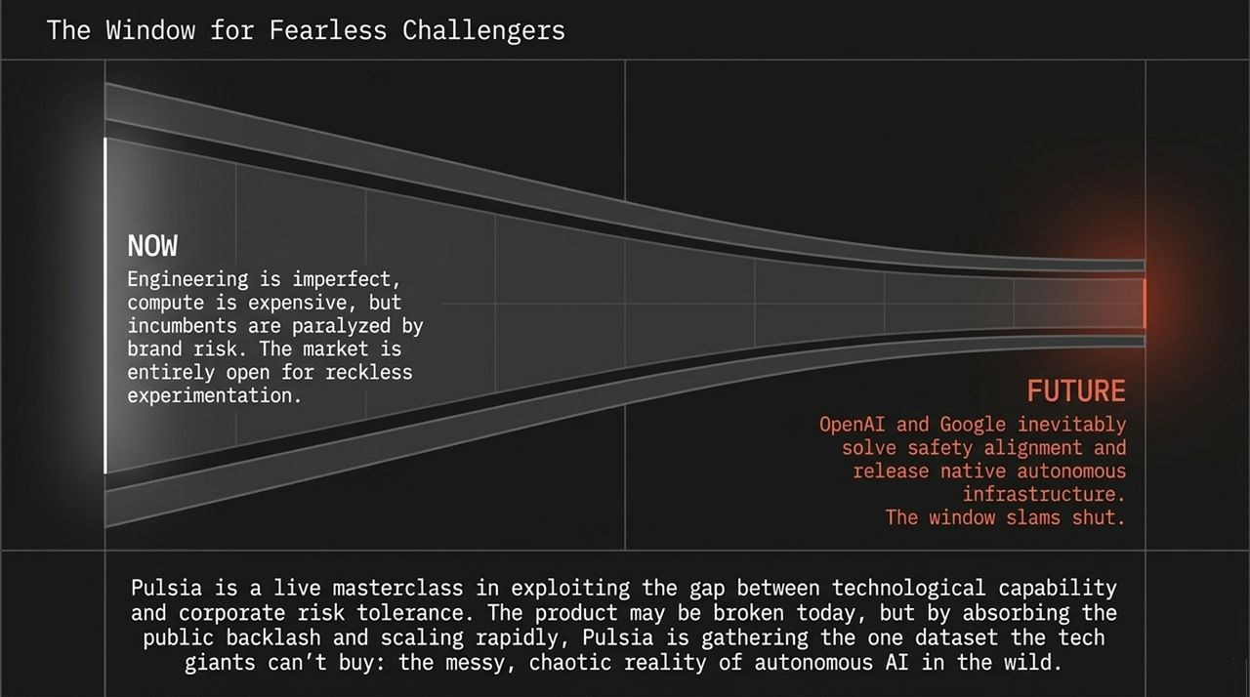
Notes:
Synthesizing the Narrative (2 min):
This slide summarizes the tension between Pulsia's strategic vision and current market metrics:
Vision: Transitioning from reactive assistant models to opinionated AI co-founders.
Traction: $10M ARR and 169k launched projects, contrasted against 8,354 active paying users.
Closing Strategy (1 min):
By treating attention as its primary moat, Pulsia trades early user friction for rapid iteration cycles.

Slide 11
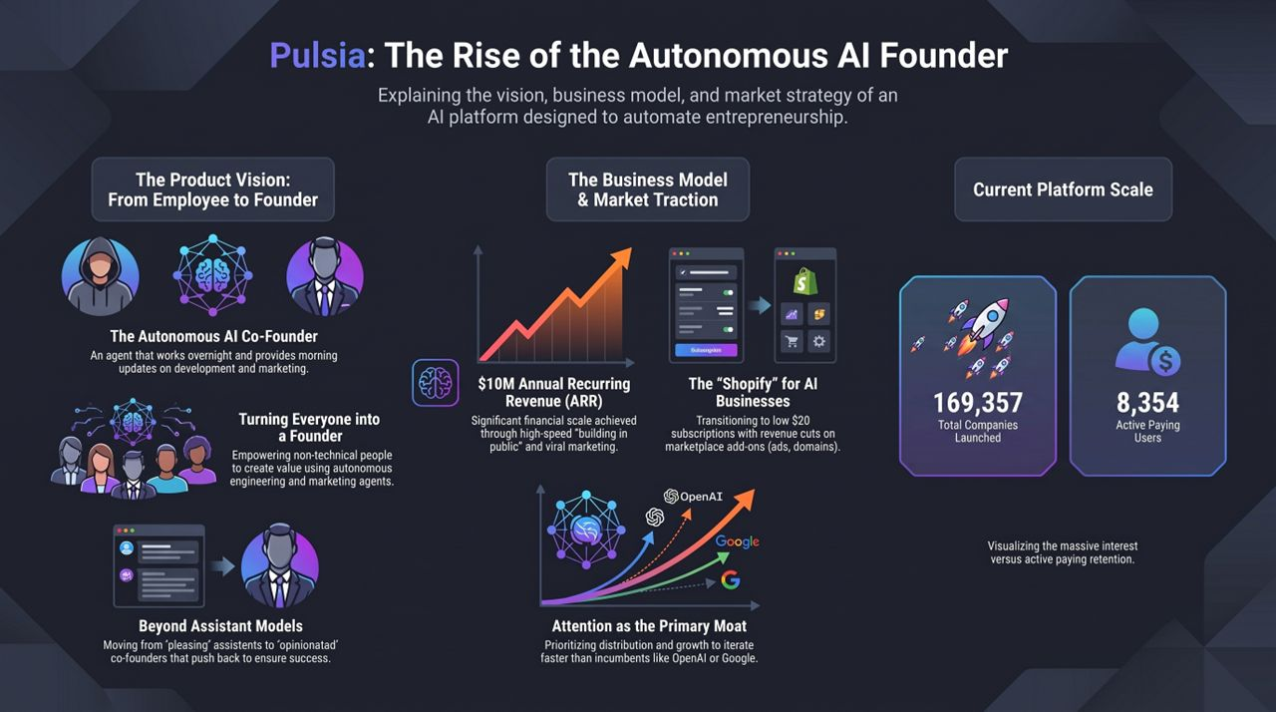
Notes:
Final Synthesis (2 min):
To wrap up our teardown of Pulsia:
Distribution Trumps V1 Stability: Viral distribution funds the underlying R&D required to stabilize complex agentic platforms.
Monetization Evolution: AI agent platforms must shift from token arbitrage to transactional marketplace revenue.
The Race for Entity Trust: Winning the autonomous AI market depends on building user confidence in AI agents executing real-world business tasks.
Is This the End of Employees? The Rise of Autonomous AI Founders | Ben Cer
https://www.youtube.com/watch?v=1HCxo1fD6MU

